Slide 1

Multi-dimensional
Array
Submitted By
Khondokar Saim – 221902353
Ashiful Haque Shihab – 221902321
Hasnat Zamil Sayad – 221902001
Submitted to
Mr. Mahbubur Rahman.
Lecturer
Email – mahbubur@cse.green.edu.bd

Slide 2
1
2
TABLE OF CONTENTS
3
4
5
What is Multi-dimensional arrays in C?
Two-dimensional array [2d]
Example of 2D array..
Three-dimensional array [3d]
Example of 3D array..

Slide 3
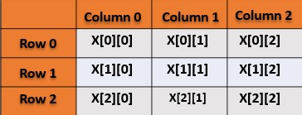
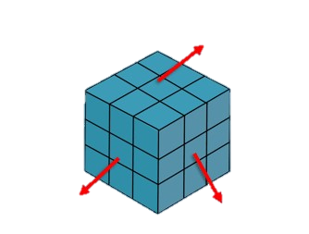
What is Multi-dimensional
Arrays in C ?
The C programming language allows us to create an array of arrays which is known as a multi-dimensional array.
Fig : 2D Array
There are various types of multi-dimensional arrays based on the number of dimensions. They are -
First
Dimensional
Two-dimensional array [2d] .
Three-dimensional array [3d].
and so on…
Second
Dimensional
Third
Dimensional
Fig : 3D Array
Notes:
Chivo

Slide 4
Two-dimensional array [2d]
Two-dimensional array declaration and Initialization Syntax:
Two dimensional array is the simplest form of a Multidimensional array.
It can be visualized as an array of arrays.
2D array is also called a matrix, we are going to discuss how we can initialize 2D array.
It can be of any type like integer, character, float, etc. depending on the Initialization.
array_name
[row_size]
data_type
[column_size]
int students[4][2] =
{
{101, 102, 103, 104}, {89, 95, 75, 82}
};
Here, an array students[4][2] can hold a total of 4×2 = 8 elements. You can imagine a two-dimensional array as a matrix. A matrix of 4 rows and each row has 2 columns.
Notes:
Chivo

Slide 5
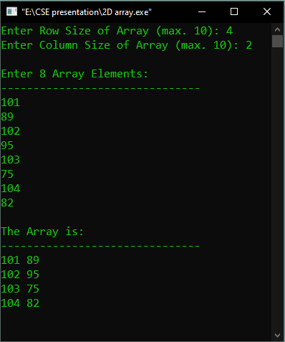
Example of 2D array ..
#include<stdio.h>
int main()
{
int arr[10][10], row, col, i, j;
printf("Enter Row Size of Array (max. 10): ");
scanf("%d", &row);
printf("Enter Column Size of Array (max. 10): ");
scanf("%d", &col);
printf("\nEnter %d Array Elements:\n", row*col);
printf("-------------------------------\n");
for(i=0; i<row; i++)
{
for(j=0; j<col; j++)
scanf("%d", &arr[i][j]);
}
printf("\nThe Array is:\n");
printf("-------------------------------\n");
for(i=0; i<row; i++)
{
for(j=0; j<col; j++)
printf("%d ", arr[i][j]);
printf("\n");
}
getch();
return 0;
}
Notes:
Chivo

Slide 6
Three-dimensional array [3d]
Three-dimensional array declaration and Initialization Syntax:
Three dimensional array is form of a Multidimensional array.
3D array is a multi-dimensional array used to store 3-dimensional information.
3D array is essentially an array of arrays of arrays : it's an array or collection 2D array. and a 2D array is an array of 1D array.
It can be of any type like integer, character, float, etc. depending on the Initialization.
[block_size]
array_name
[row_size]
data_type
[column_size]
int arr[3][4][2] =
{
{2, 4}, {7, 8}, {3, 4}, {5, 6} },
{ {7, 6}, {3, 4}, {5, 3}, {2, 3} },
{ {8, 9}, {7, 2}, {3, 4}, {5, 1} }
};
Notes:
Chivo

Slide 7
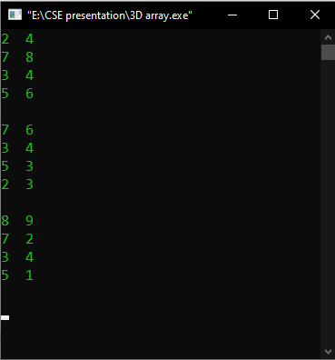
Example of 3D array ..
#include<stdio.h>
#include<conio.h>
int main()
{
int i, j, k;
int arr[3][4][2] = {
{ {2, 4}, {7, 8}, {3, 4}, {5, 6} },
{ {7, 6}, {3, 4}, {5, 3}, {2, 3} },
{ {8, 9}, {7, 2}, {3, 4}, {5, 1} }
};
for(i=0; i<3; i++)
{
for(j=0; j<4; j++)
{
for(k=0; k<2; k++)
printf("%d ", arr[i][j][k]);
printf("\n");
}
printf("\n");
}
getch();
return 0;
}
Notes:
Chivo

Slide 8
Thank You !

